Slide 1
AGROBIODIVERSITY CONSERVATION-microbes, traditional crops, indigenous livestock breeds
Percy Chimwamurombe
pchimwa@gmail.com

Slide 2
Outline of Presentation
Introduction
Climate Change-Problem context
Agrobiodiversity
Traditional crops: cowpea, Bambara ground nut, marama bean, water lily, Indigenous livestock breeds
Biological Nitrogen Fixation
Research Issues
Key Results
Marama-bacteria interactions
Biofertilizer Inoculant Technology
Way forward Recommendations
Acknowledgements

Slide 3
Climate Change
a change in global or regional climate patterns

Slide 4
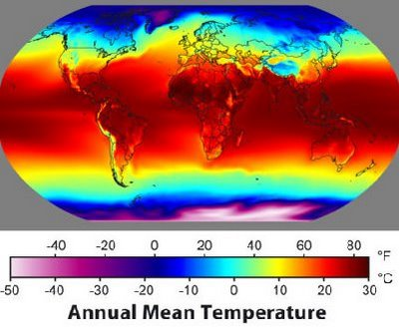
Annual mean temperature
Three issues:
Hotter and drier
Loss of soil due to extending desert
Crop failure
Notes:
Background
Climate – global temperature – highest mean in W Africa/India – most susceptible to rise
We will be focusing on Sahel – one of the poorest and most vulnerable regions in the world – already suffering hunger
Suffering fourfold future issues to make things worse
Hotter and drier
Loss of soil as Sahara spreads south
Crop Failure
Increasing population – already 100m predicted in one model to treble by 2050

Slide 5
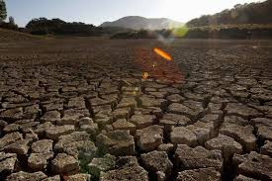
Climate change has clear predictable negative impacts in human nutrition (health) and agriculture

Slide 6
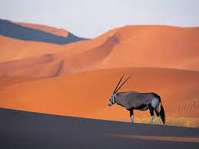
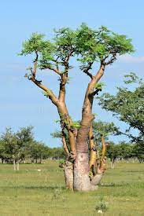
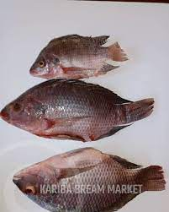
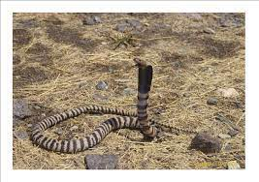
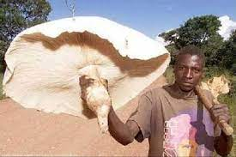
What is Biodiversity Conservation?
Biodiversity conservation, the practice of protecting and preserving the wealth and variety of species, habitats, ecosystems, and genetic diversity on the planet, is important for our health, wealth, food, fuel, and services we depend on.
Biodiversity conservation is vital for economic growth and poverty reduction.

Slide 7
What is Agrobiodiversity?
Agrobiodiversity is the wealth of different plants, animals, and microbes that make up our agricultural systems. It is the menu of different foods we eat. It is the foundation of resilient, sustainable, and nutritious food systems

Slide 9
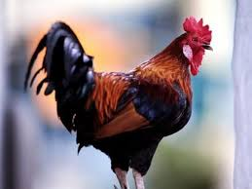
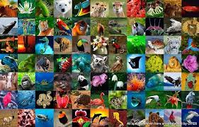
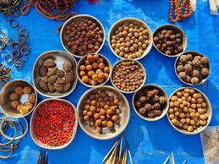
Agrobiodiversity
Improve nutrition and food security. Increase productivity and economic return.
Make farming systems more reliable and sustainable.
Reduce the impact of agriculture on vulnerable environments, especially forests and endangered species.

Slide 10
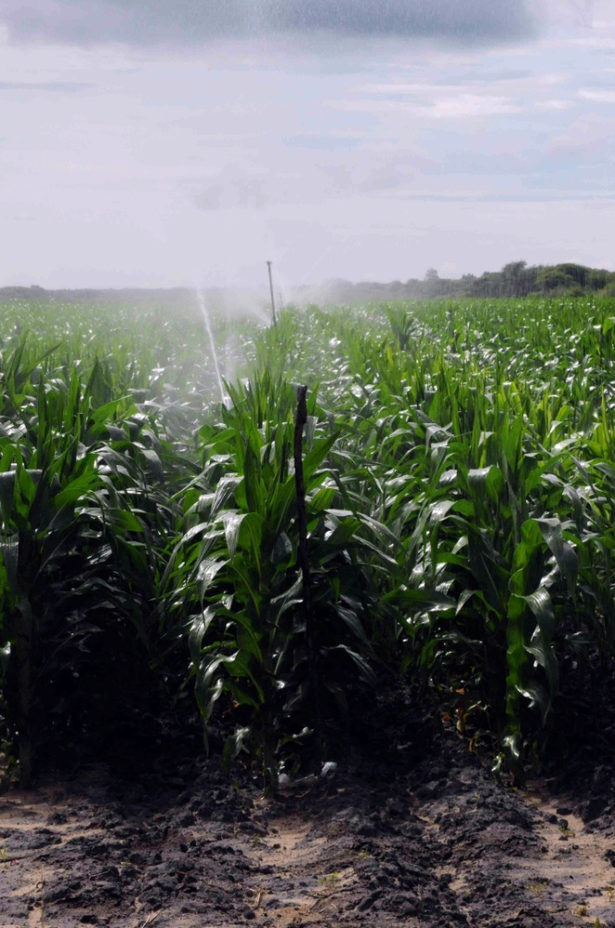
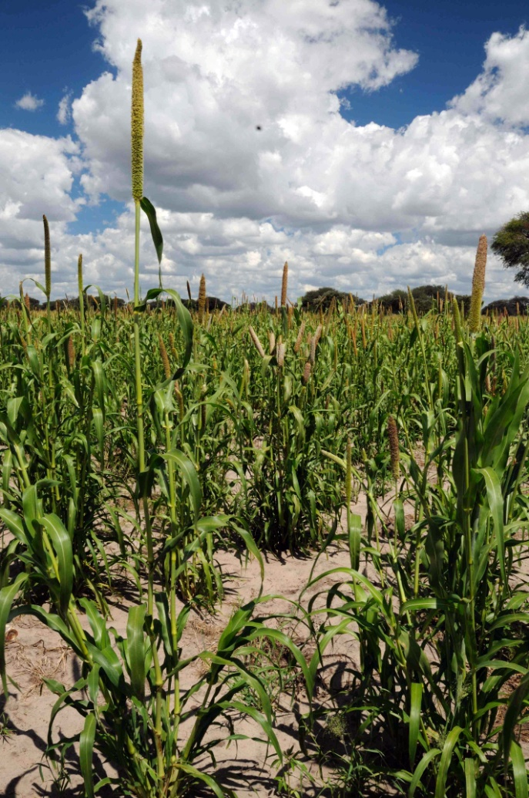
Many regions in Namibia and SSA are dominated by smallholder farming
Dominantly Smallholders: dryland agriculture
Irrigation agriculture
Smallholders: Bushveld

Slide 11
Nutritious traditional crops
Used in smallholder farming:
Protein-rich crops like pulses are of advantage:
Have higher protein levels than cereals (“meat of the poor”)
Can thus improve malnutrition
Can be grown with low N-fertilizer (see below)
Can improve soil fertility
Cowpeas
Bambara ground nut
Millets
Sorghum

Slide 12
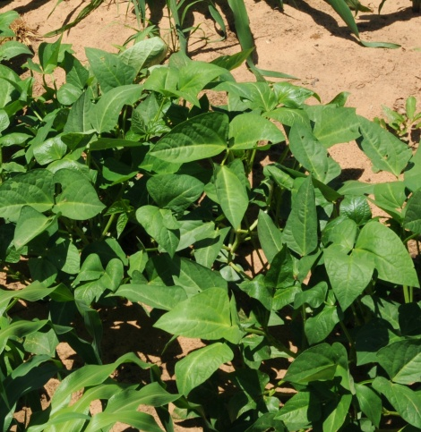
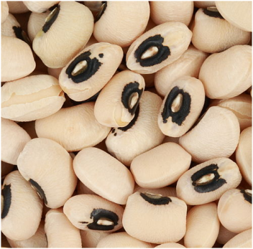
Cowpea

Slide 13
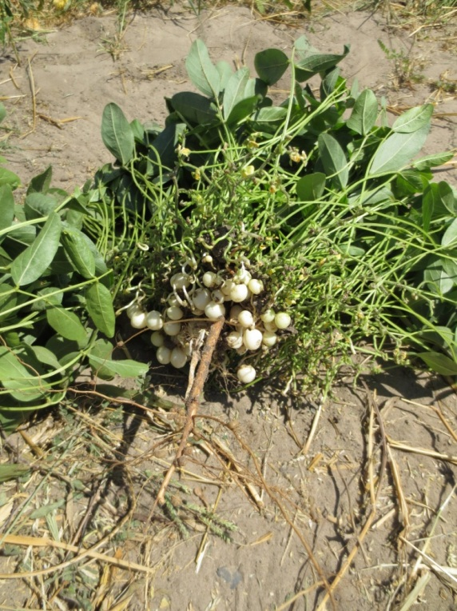
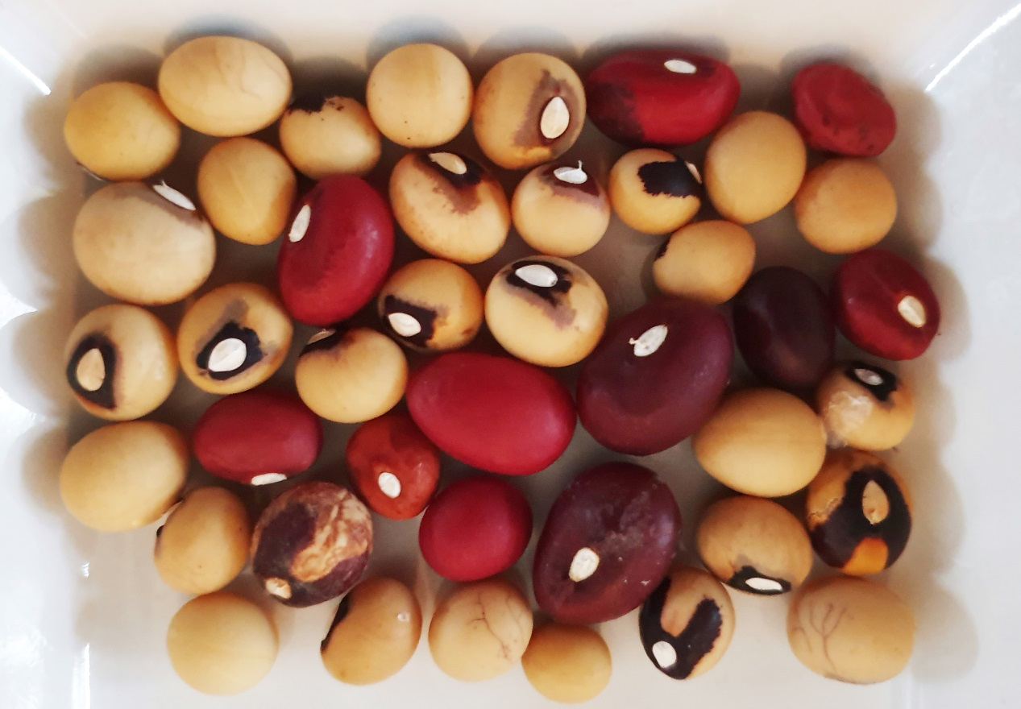
Bambara ground nut

Slide 14
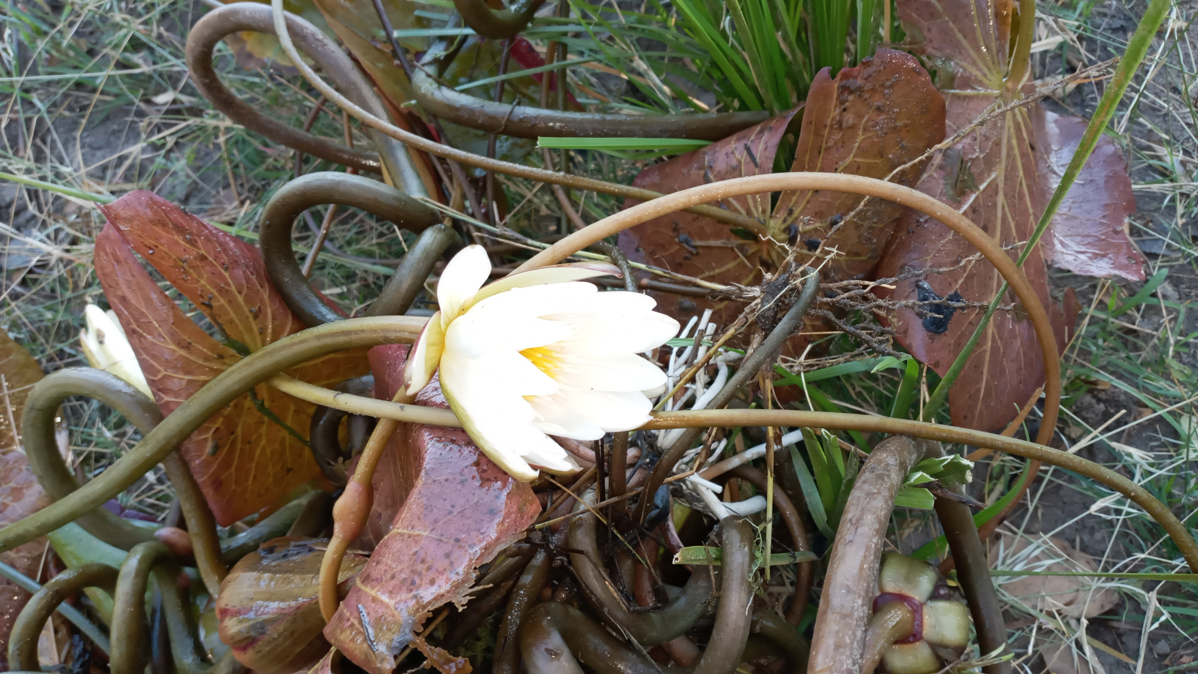
Water Lily

Slide 15
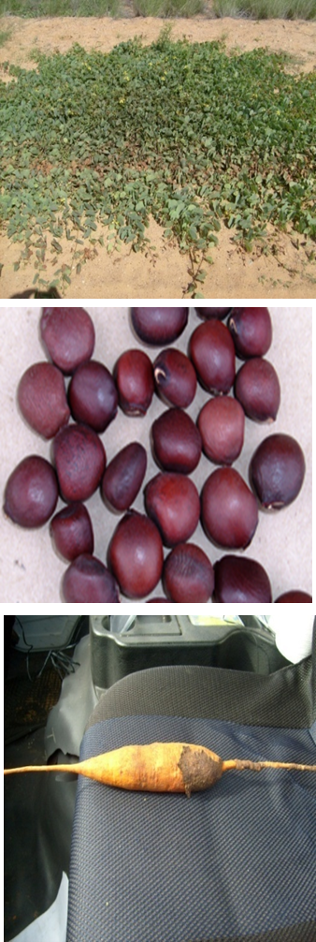
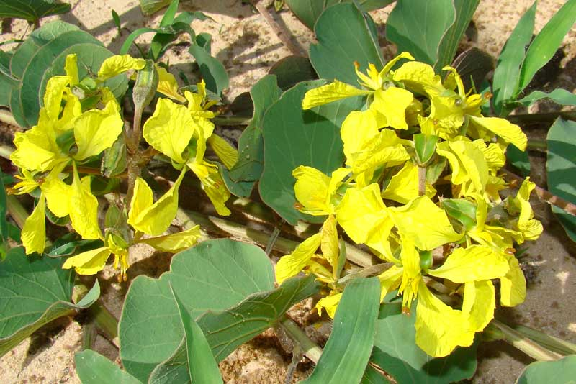
Marama bean

Slide 16
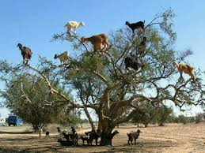
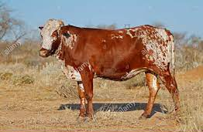
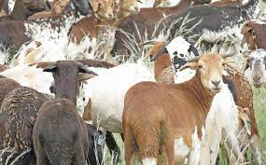
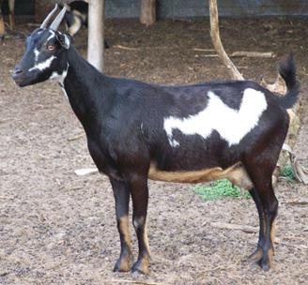
Indigenous livestock breeds
Sanga cow
Damara sheep
Sustainable
Fodder production!?
Namibia Veld Goats

Slide 17
microbes
microbes
Micro-organisms

Slide 18
Agricultural low yields due to:
declining soil fertility
low input of fixed nitrogen
Chemical Fertilizers: Problem? (greenhouse gases and leaching)...COST
N acquisition pathways in nature?

Slide 19
Biological Nitrogen Fixation

Slide 20
Major Pathways for N Acquisition
All biological compounds contain N in a reduced form
The principal inorganic forms of N are in an oxidized state
Thus, N acquisition must involve reduction of the oxidized forms (N₂ and NO₃⁻) to NH₄⁺
Nearly all of this is in microorganisms and green plants.
Animals gain N through diet.

Slide 21
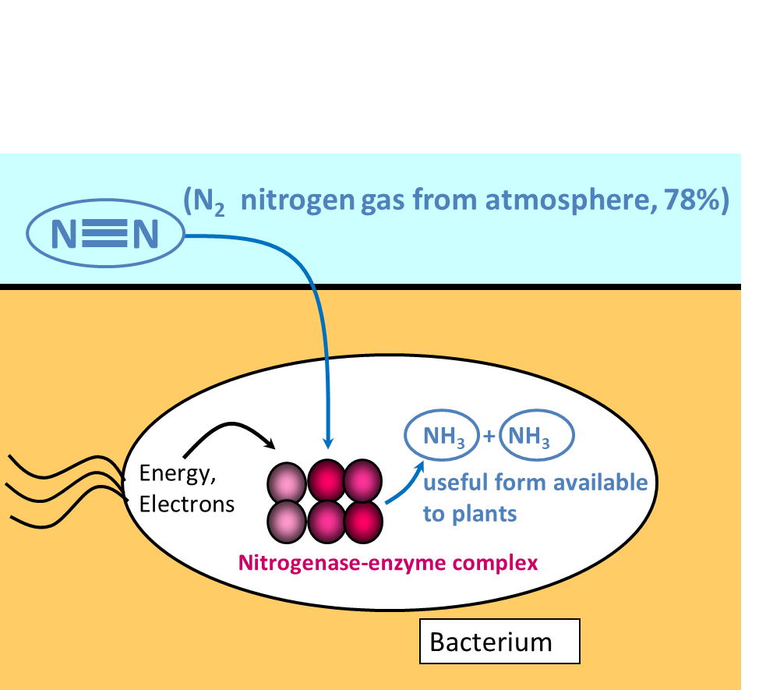
Biological nitrogen fixation for N-Input

Slide 22
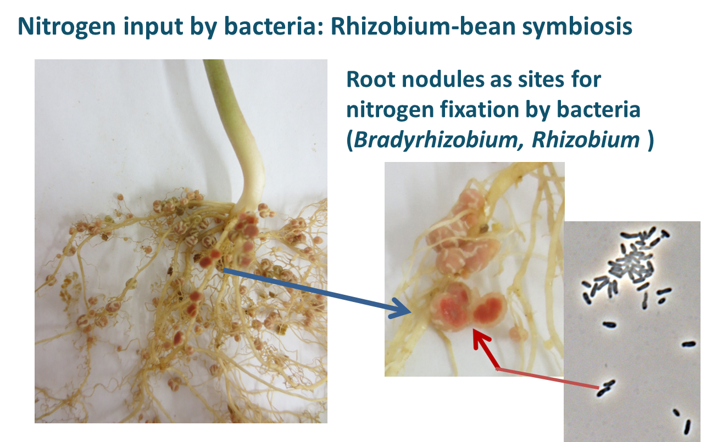
Biological nitrogen fixation for N-Input

Slide 23
Dryland Agriculture Kavango Region Namibia, Botswana

Slide 24
Science-based Solutions:

Slide 25
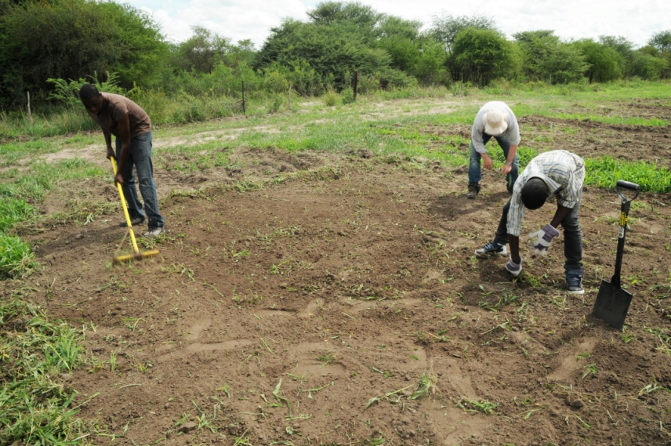
Science-based Solutions:

Slide 26
Research Issues
Malnutrition
Water scarcity
Frequent droughts
Poor seed pools
Land degradation
Crop diversity – Food diversity
Climate variability
Soil fertility
Fodder availability
Loss of agrobiodiversity
Food security and household livelihoods
Food and disease pandemic readiness
Dryland agriculture adaptation

Slide 27
SELECTED Key Results

Slide 28
On-Farm Cultivation Trials
One farm in Okakarara
4 farms in Epukiro
2 farms in Vaasdraai (Tjaka)
Planned 12 farms in Omaheke region with NEPAD support
Kirkhouse Trust (supporting seed production for world supply)

Slide 29
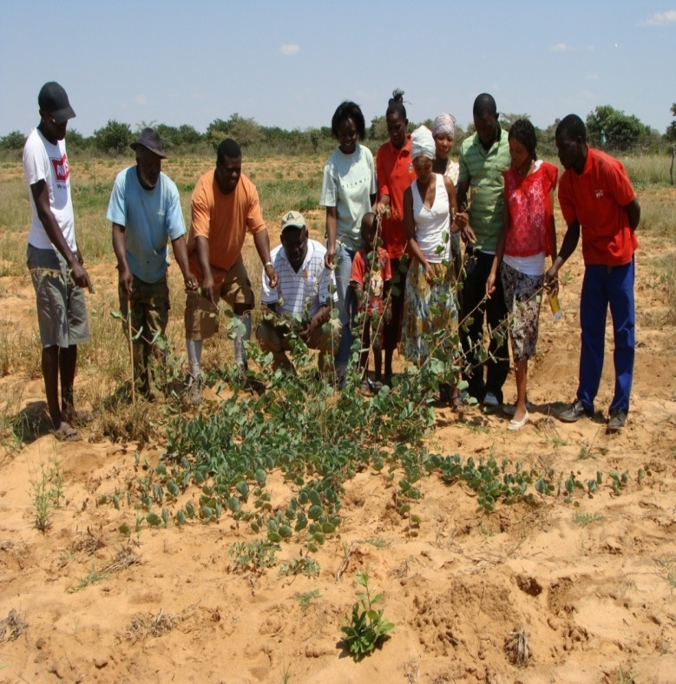
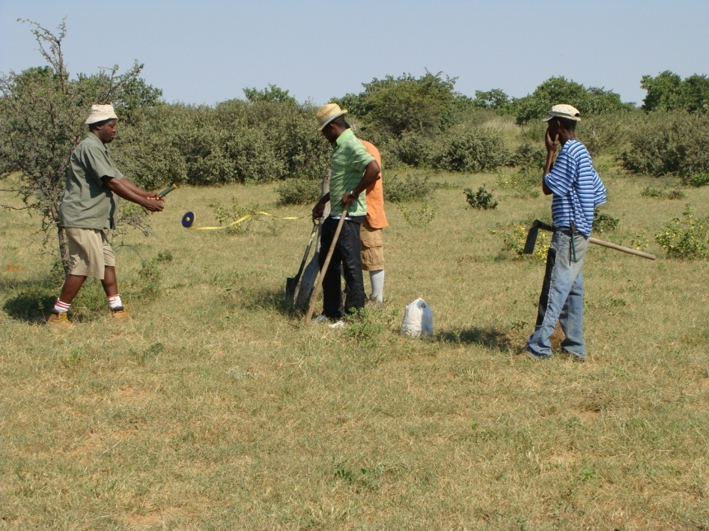
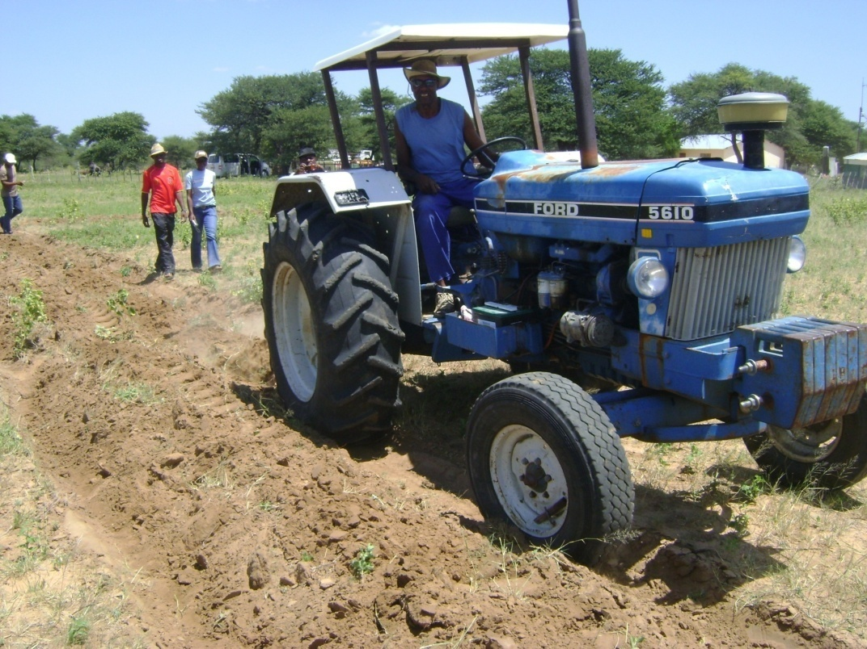
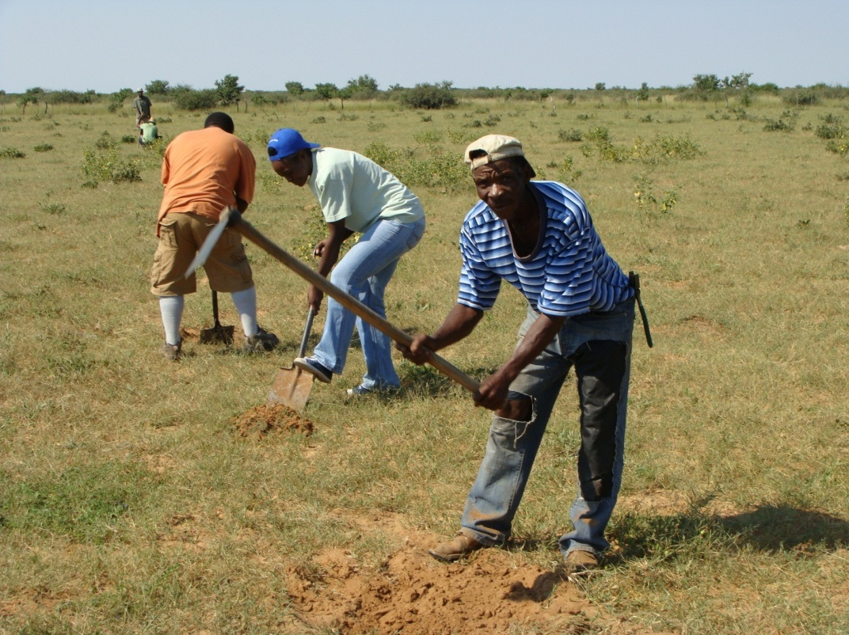

Slide 30
Bacteria interact with Marama bean: 1. nitrogen fixation, 2. growth enhancement 3.aridity adaptation
Marama bean
BACTERIA

Slide 31
We now know that marama bean seeds are home to at least:
33 culturable bacterial species from 12 genera including Bacillus, Rhizobia, Curtobacterium, Pantoea, Microbacterium, Enterobacter, and Burkoholderia were isolated.
2. 16 isolates with <99% similarity to published 16SrDNA sequences were treated as potential new species and work is ongoing to characterize and describe them further.

Slide 32
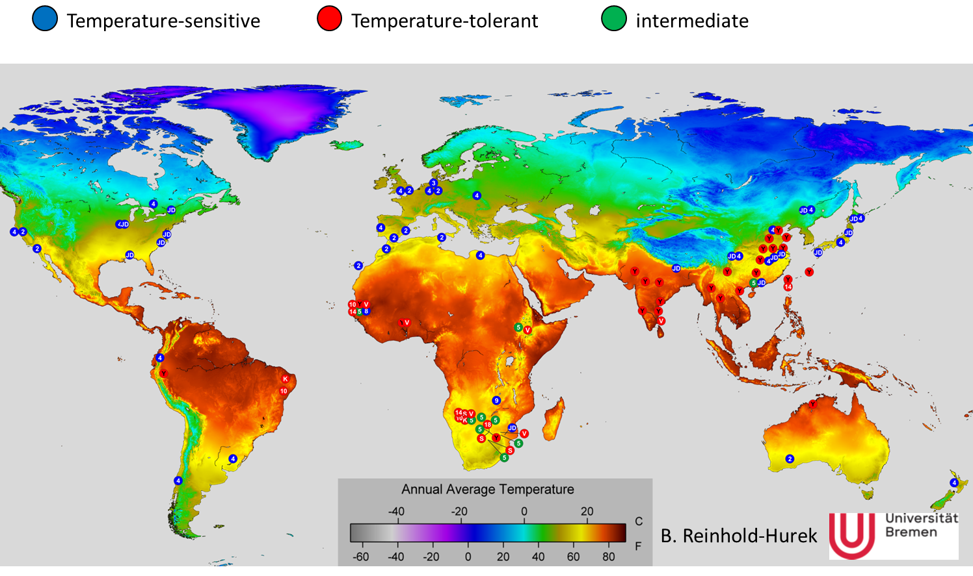
Many novel heat-tolerant rhizobia from Namibia, SA

Slide 33
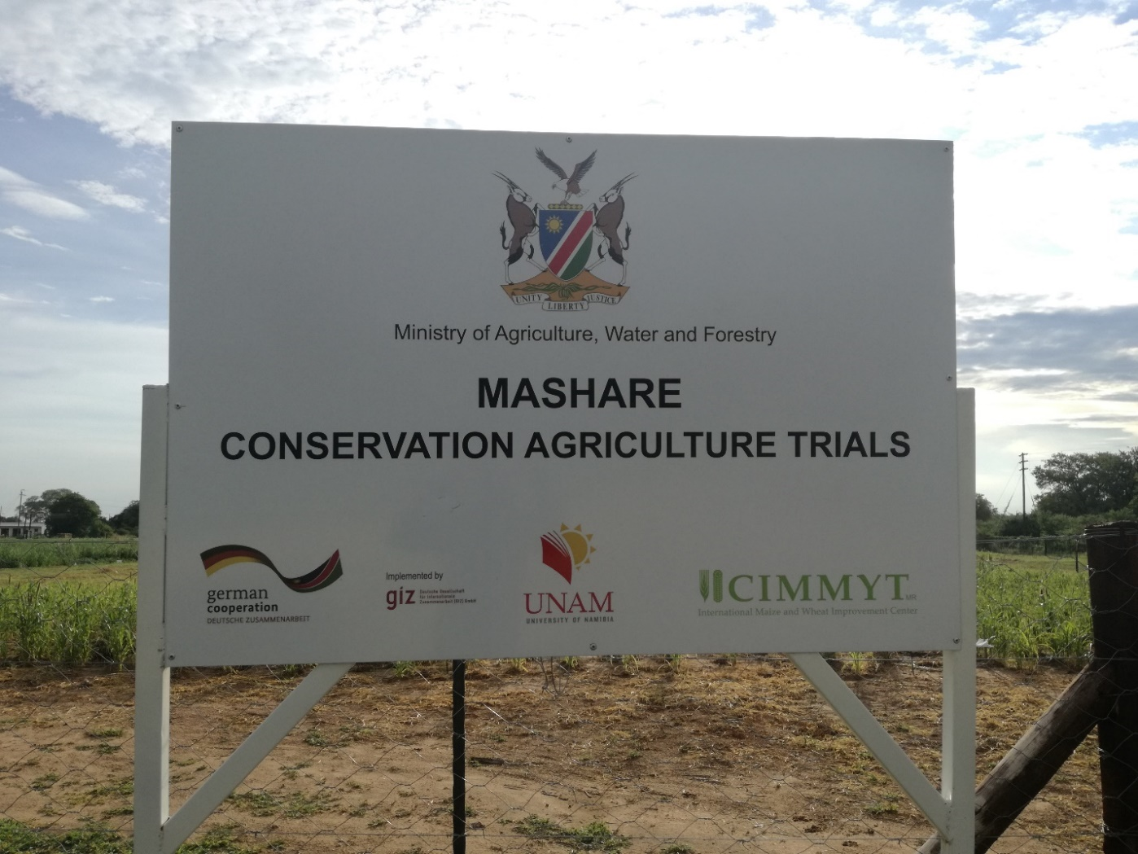
Field Trials, Season 1

Slide 34
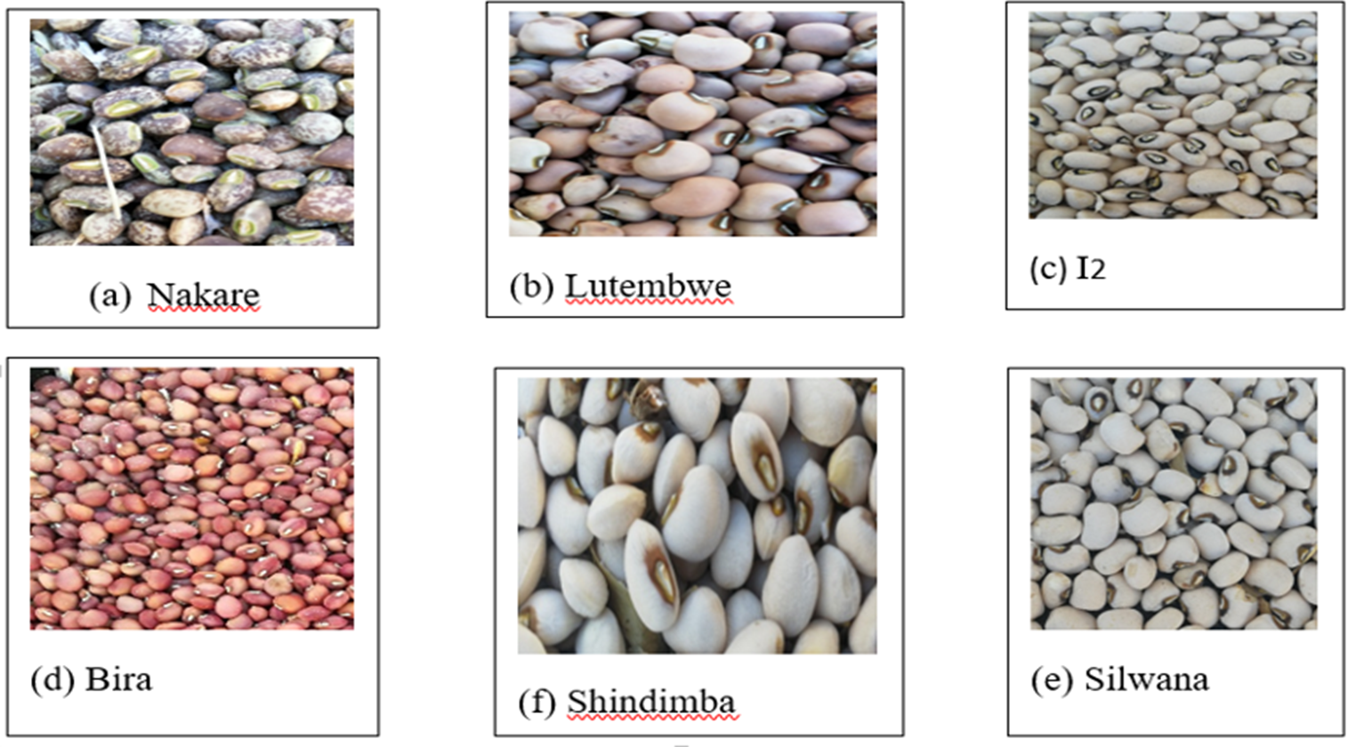

Slide 35
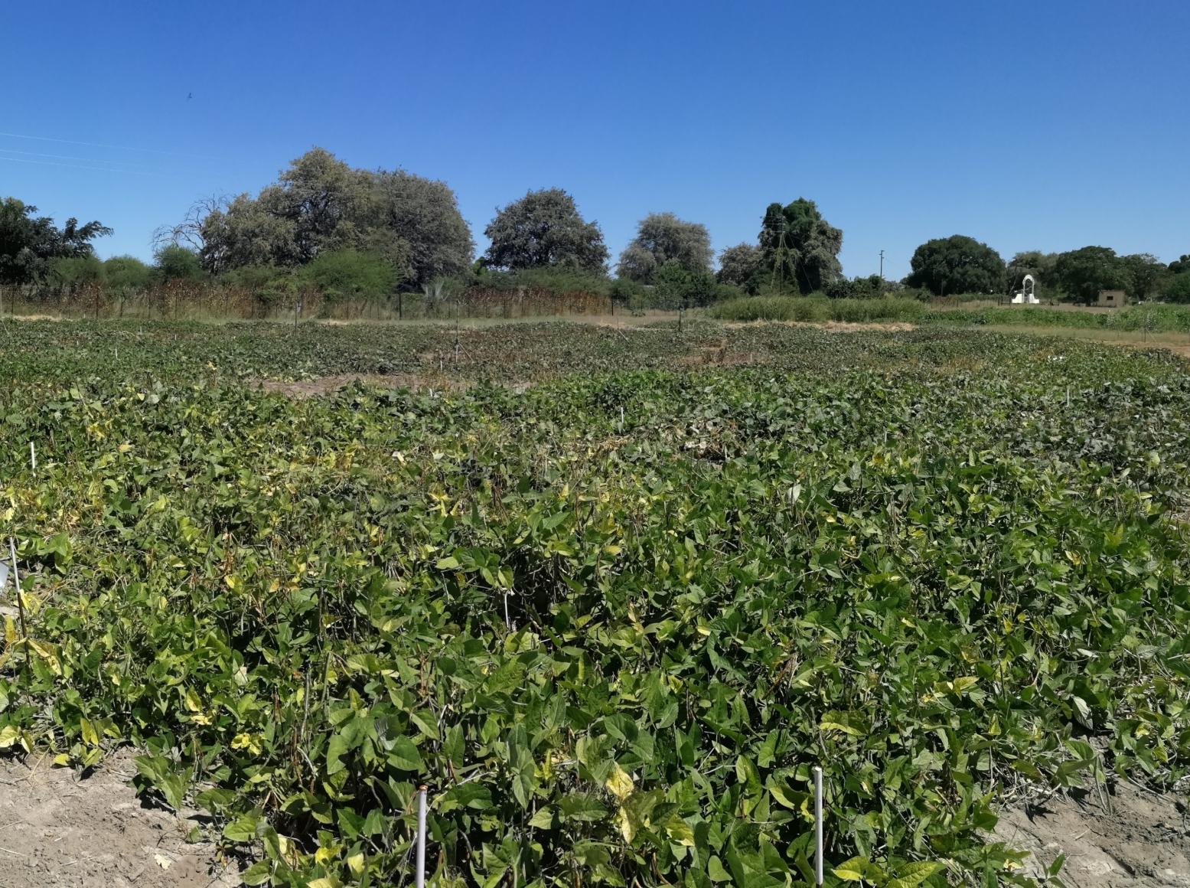
Mashare , Field trial plot season 1
In our study, fertilizer = 1149.95kg/ha and bio-inoculant 2651.24kg/ha
Similar results in Ogongo, Omusati region
New biofertlizer performs better that chemical fertiliser

Slide 36
Way Forward & Recommendations
Food Security (urban vs rural)
Nutritional Security (urban vs rural)
Pandemic Readiness (Vitamin C, Selenium, Zinc, Vitamin D, other minerals)
Harness Agrobiodiversity
Combating Land degradation using crops
Harnessing use of microbes in Agriculture: Biofertilizers: Rhizobia, Bradyrhizobia, Azospirillum etc
One –good plant – per household approach (Moringa)
Introduce new alternative crops cultivars: Moth bean, Mungbean, horse gram, dolichos, marama bean, water lilies, Cleome gyndra, Amaranthus, Mutate, etc
Strengthen agrobiodiversity conservation at community level and at national level

Slide 37
Acknowledgments
PROF BARBARA REINHOLD-HUREK
TOPSOIL , BMBF , GERMANY
Abiud Kamburona
Charlie Luchen
Florence Mukelabai
Paidamoyo Mataranyika
Nande Uusiku
Dr JD Uzabakiriho
Ruben Shou
Marcus Kamburu
Daniel Haiyambo
Julia Sepe

