Slide 1
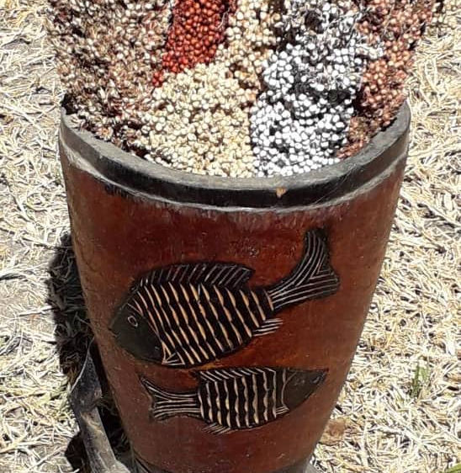
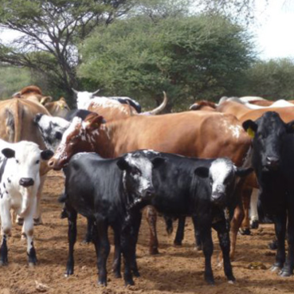
Organic Agriculture
Opportunities & Importance
Globally and in Namibia
8 September 2021
www.noa.org.na

Slide 2
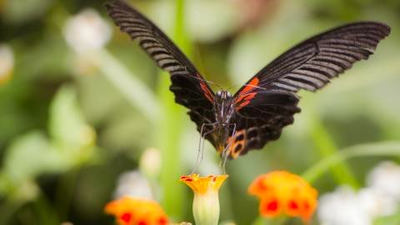
What is Organic Agriculture?
Ecosystems => Biodiversity =>
Nutrient Cycles => Microbiology
Adapted Management:
No Synthetics,
No Harmful Chemicals,
No GMOs
HEALTH | ECOLOGY | FAIRNESS | CARE

Slide 3
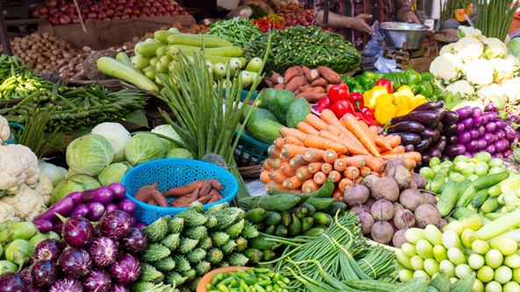
The Organic Market Worldwide

Slide 4
In 2019
the global market reached
106 billion Euro
Organic turnover increased more than tenfold since 2000
Namibia has preferred access
to major
international
markets
Market Demand

Slide 5
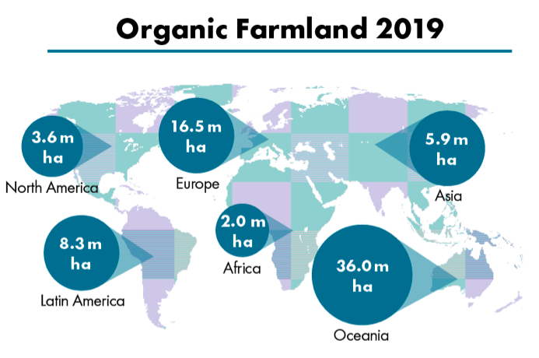
2018 to 2019 Africa’s
organic farmland
grew 9.5%
Land Use
Wild collection:
2.5 million ha
Namibia has the
3rd highest worldwide

Slide 6
Ethics
Animal Welfare
Health
Market Drivers
Nature
Health
Nutrition
HEALTH | ECOLOGY | FAIRNESS | CARE

Slide 7
Eco-Labels
Organic
Standards
Certification

Slide 8
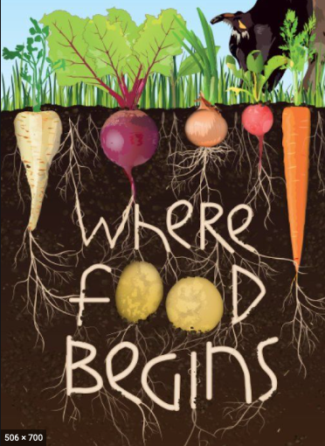
The Organic Benefits for Namibia
Resilience
Health
Nutrient rich food
Alive with
healthy microbes
Suppressing disease
Moisture absorbing & retaining
organic soils

Slide 9
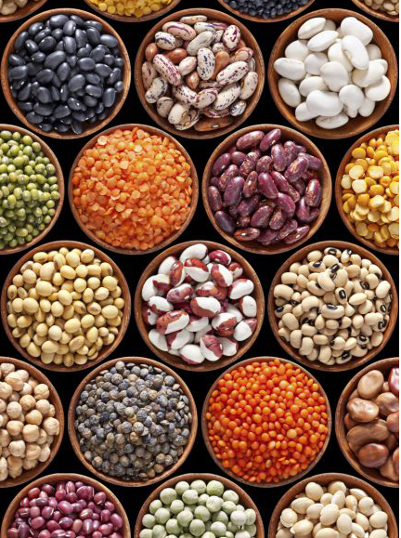
The Organic Benefits for Namibia
Environment
Abundance
Multiple
Income Streams
Profitability
Sustainability
Biodiversity
Climate
Carbon Sequestration

Slide 10
KCOA - Knowledge Centre for Organic Agriculture
Data Collection:
Multipliers
Producers
Processors
Information
Strategies
Best Practices
Networking
Organic value chains
Stakeholders

Slide 11
Thank You!
www.noa.org.na

